Slide 1
Proposal Presentation
Matting based on Bayesian algorithm
Lingyu Gong, Changhong Li, Qiwen Tan
E3 School
Date 15/02/2024

Slide 2
Content
Group Introduction(Tan )
Mathematical Algorithm(Tan )
Function Blocks(Gong)
Testing Plan(Gong)
Flow of Implementation(Changhong)
Milestones and timeline(Changhong)

Slide 3
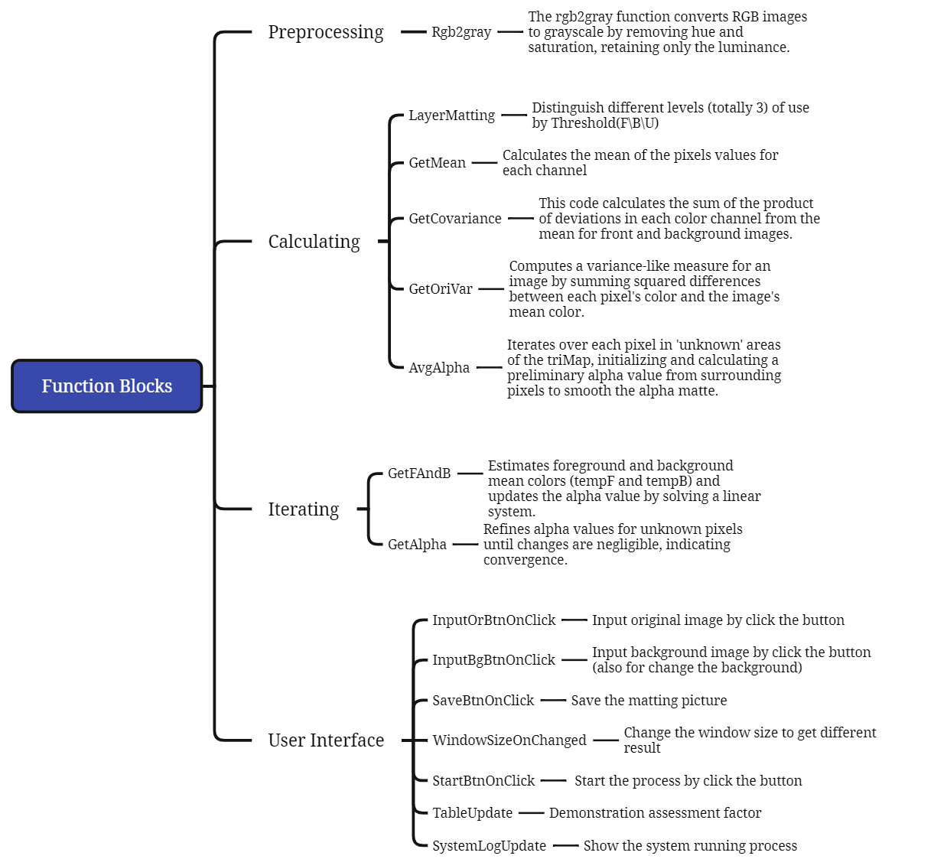
Function Blocks
Preprocessing
Simplification: Efficiency, Streamlining, Single Intensity.
Threshold Consistency: Predefined Thresholds, Intensity Classification.
Standard Matting Practice: Image Matting, Grayscale Guide.
Compatibility with Logic: Processing Consistency, Intensity-based Logic.

Slide 4
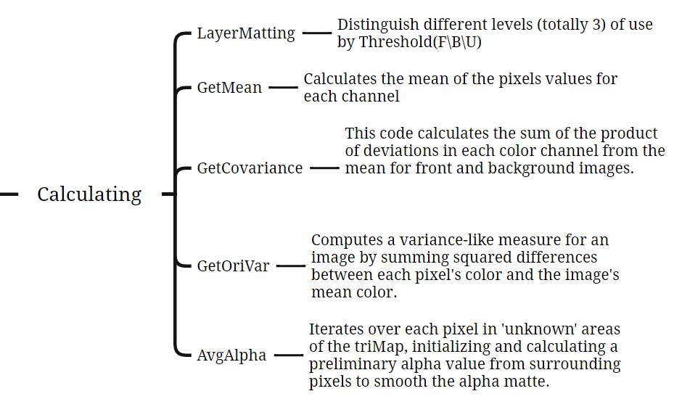
Function Blocks
Calculating
The calculations provide key color insights for distinguishing the foreground from the background, crucial for areas with unclear boundaries like hair or fur.
Mean Calculation: Color Averaging, RGB Channels, Region Centrality
Covariance Matrix: Color Variation, Channel Relationship, Texture Analysis
Normalization: Scale Adjustment, Pixel Count Relevance, Average Representation
Variance Calculation: Noise Estimation, Texture Characterization, Color Deviation Measurement

Slide 5
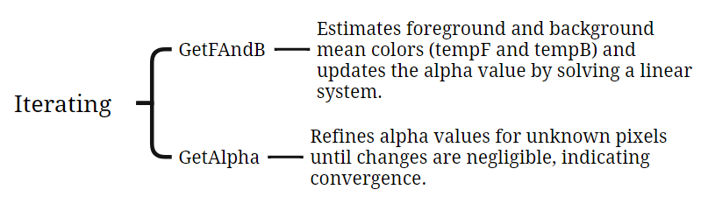
Function Blocks
Iterating
This part will refine the alpha matte in complex image areas (such as edges, hair, fur) by iteratively adjusting transparency and color for precise foreground-background separation.
Alpha Matte Refinement: Precise Transparency Adjustment
Complex Area Focus: Edge, Hair, Fur Detailing
Iterative Calculations: Repeated Fine-Tuning
Foreground-Background Separation: Accurate Color Segregation
Transparency Calculation: Alpha Value Determination
Color Matching: Foreground-Background Color Alignment
Convergence Check: Optimal Alpha Value Assessment

Slide 6
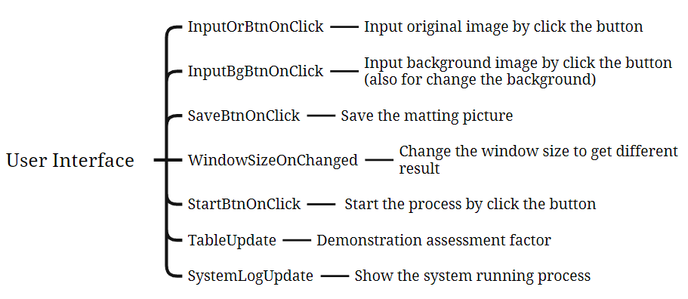
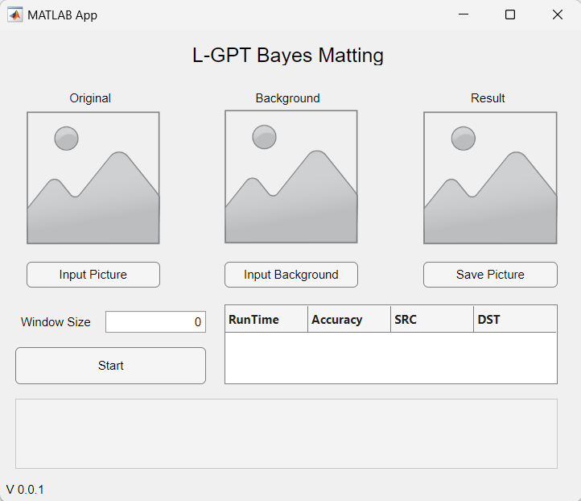
Function Blocks
User Interface
Data visualization capabilities
Easy integration with MATLAB's computational functions
User-friendly interface for creating and customizing GUIs without needing extensive programming skills.

Slide 7
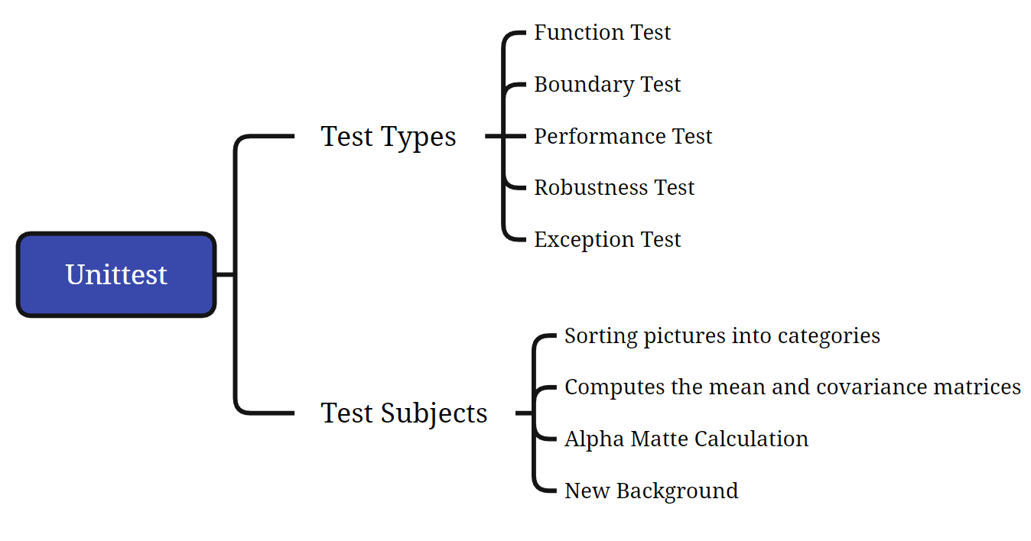
Unittest

Slide 8
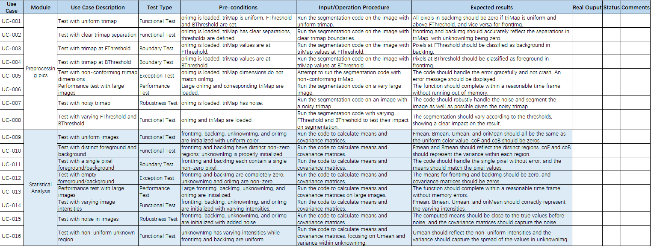
Unittest

Slide 9
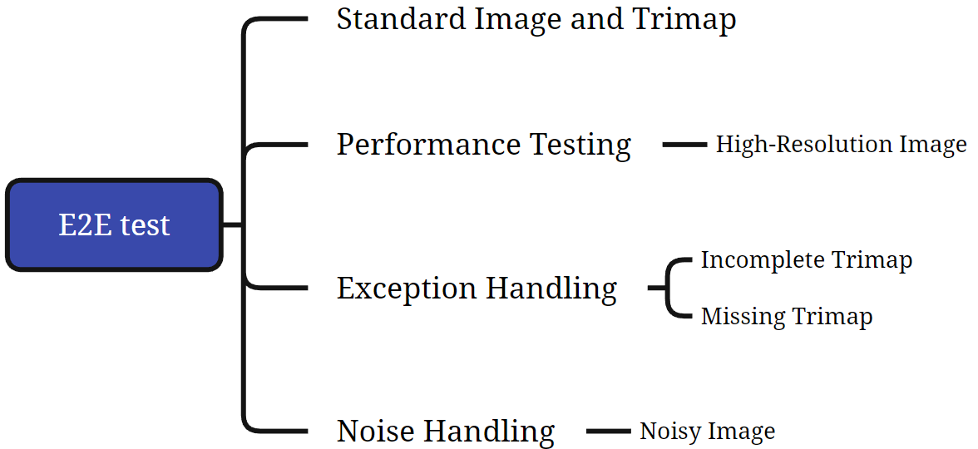
E2E test

Slide 10
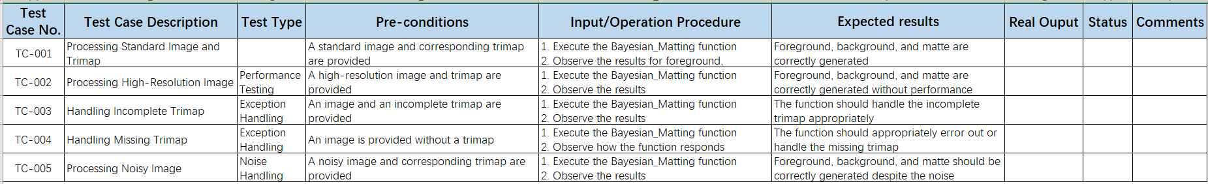
E2E test

Slide 11
Thank You

